Slide 1



Server Lifeboat
Under the guidance of :
Mr. Sandeep Walvekar Sir
In partial fulfillment of the award of Post Graduate Diploma in
IT Infrastructure, Systems and Security
(PG-DITISS)
Sunbeam Institute of Information Technology,
Pune (Maharashtra)
PG-DITISS -2024
Submitted By:
Kaustubh Deochake: 240344223008
Kiran Patil: 240344223024
Rupesh Modi: 240344223019
Ujjwal Shelke: 240344223037

Slide 2
INTRODUCTION
Automate the backup process
Ensuring Data Integrity and Availability
To establish a reliable system for automatic data backup
Use of scheduled tasks to perform backups
Implementation of full, incremental backups to optimize storage

Slide 3
Project Scope
Infrastructure Assessment
Backup Strategies
Full Backups
Incremental Backups
Automation and Scheduling
Monitoring

Slide 4
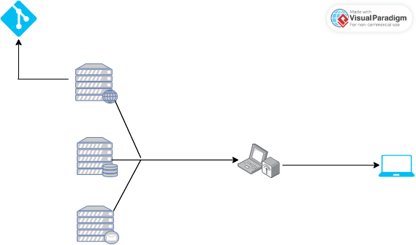

Architecture Overview

Slide 5
Backup Strategies
Full Backup: A complete copy of all data at a specific point in time. While easy to restore, it requires significant storage space and time to complete.
Incremental Backup: Backs up only the data that has changed since the last backup (whether it was full or incremental). This method saves storage space and reduces backup time but can complicate the restore process.
Differential Backup: Captures all changes made since the last full backup. This strikes a balance between full and incremental backups, allowing for easier restoration while still saving space compared to full backups.

Slide 6
Technology used
Web Server
Database Server
Mail Server
rsync Command
Crontab
GIT
Nagios
Snort

Slide 7
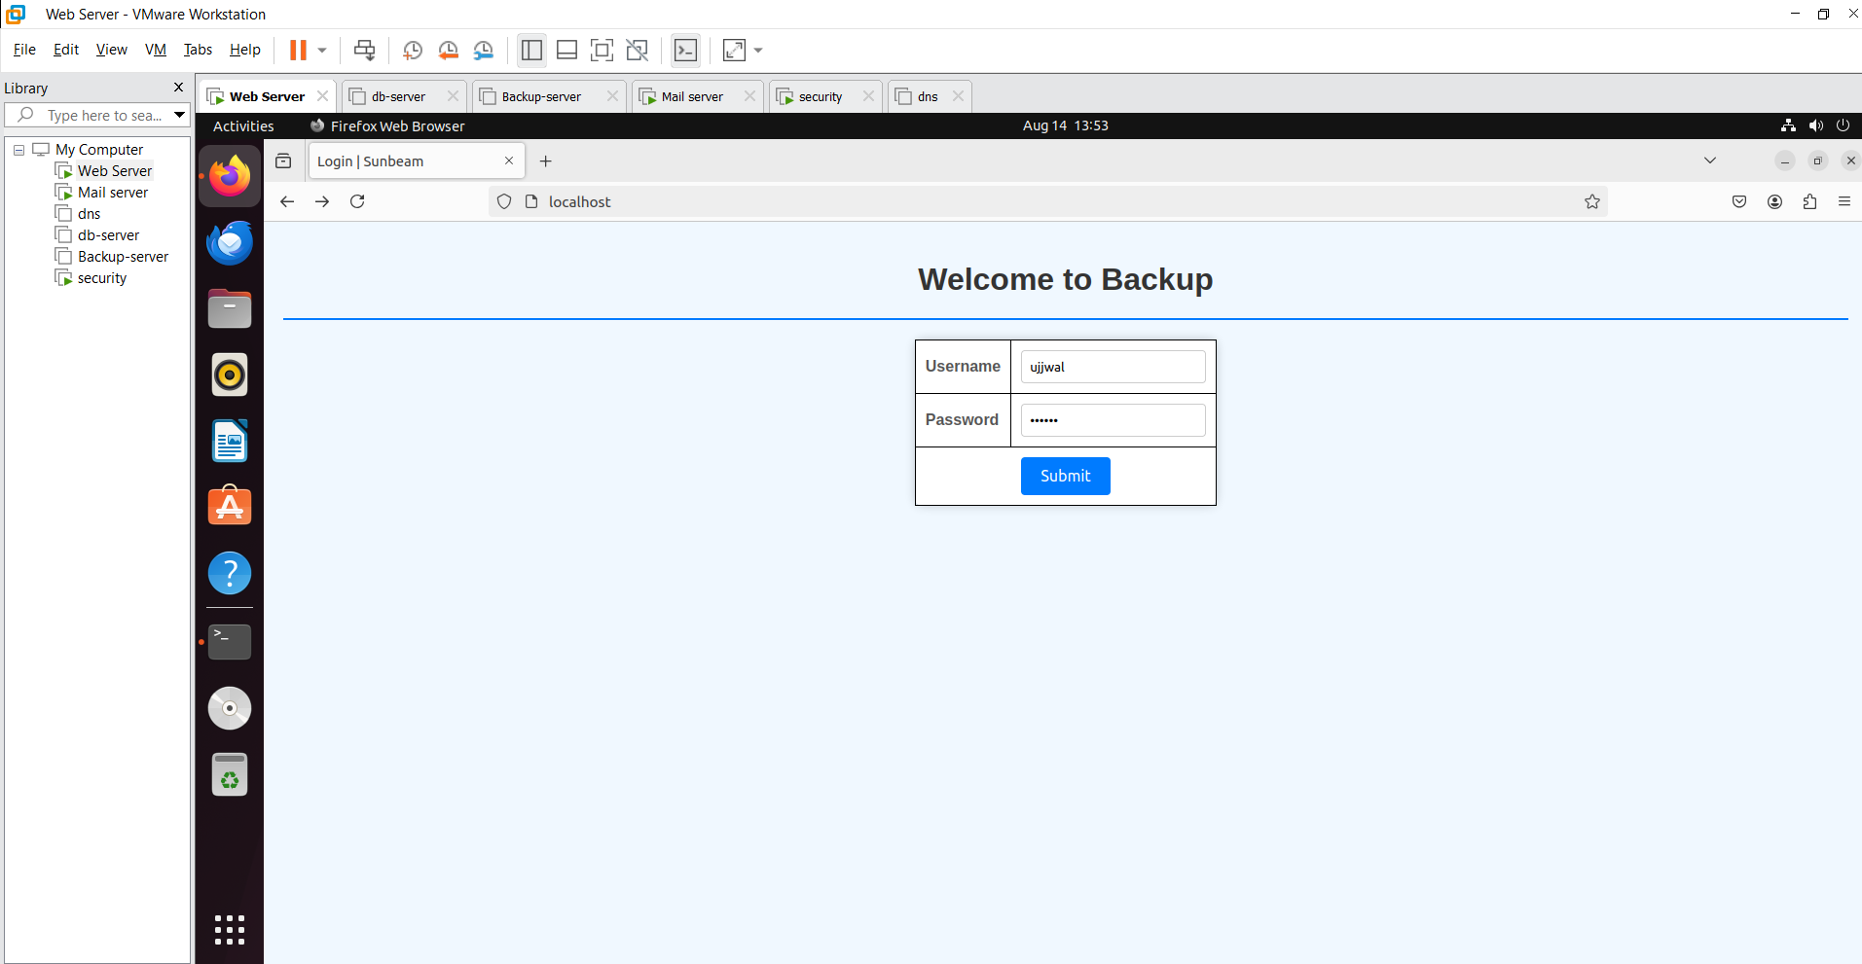
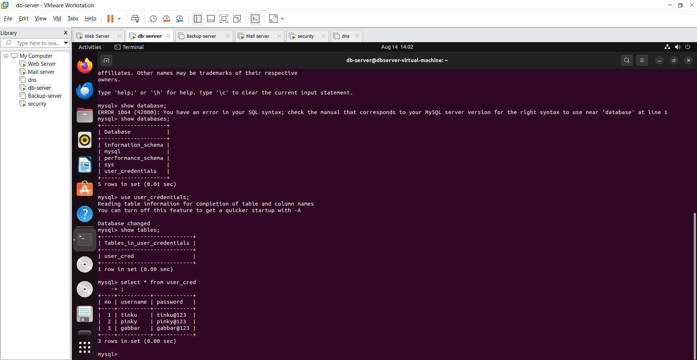
Project OutPut:

Slide 8
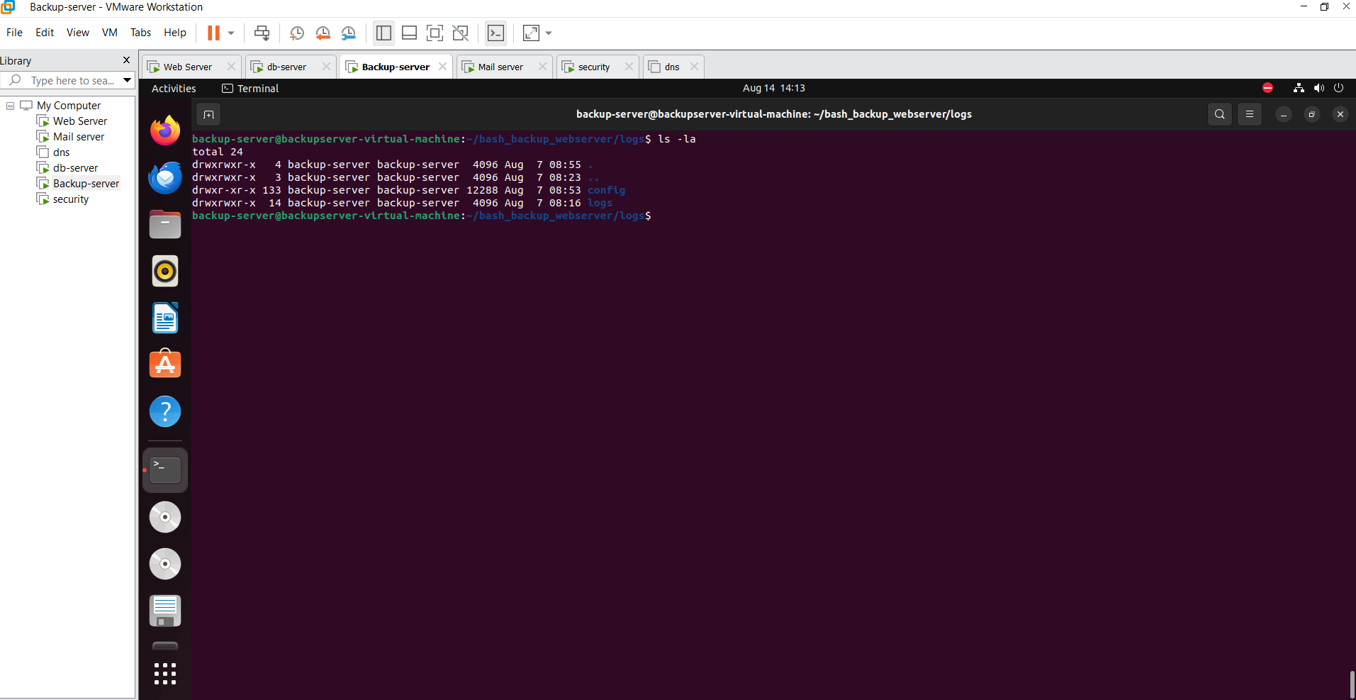
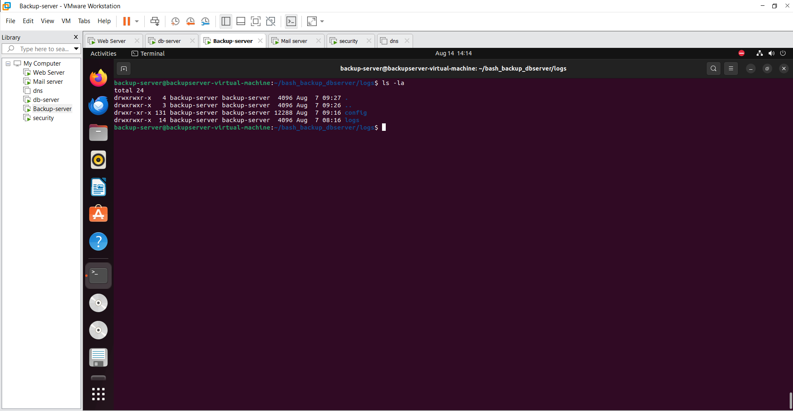
Remote machine with Web server machine backup
Remote machine with Database server machine backup

Slide 9
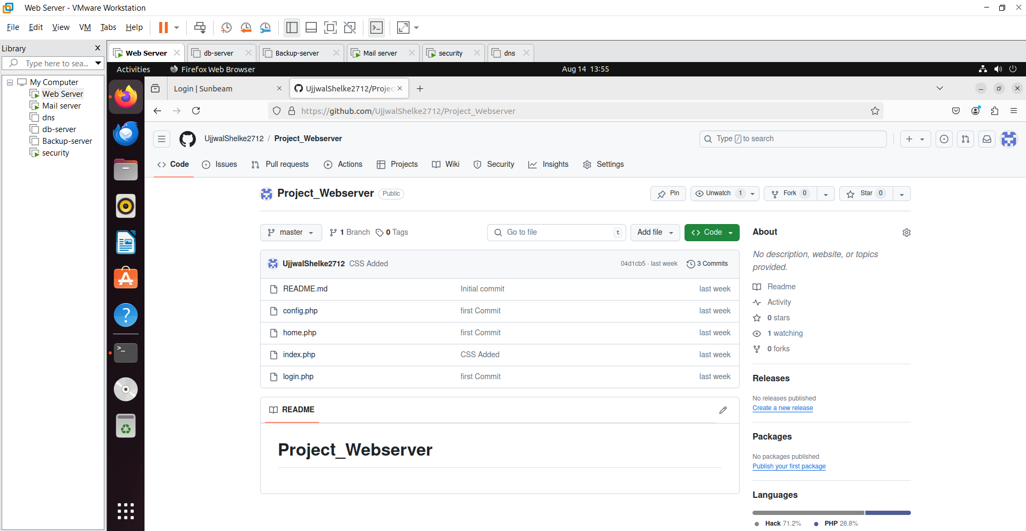
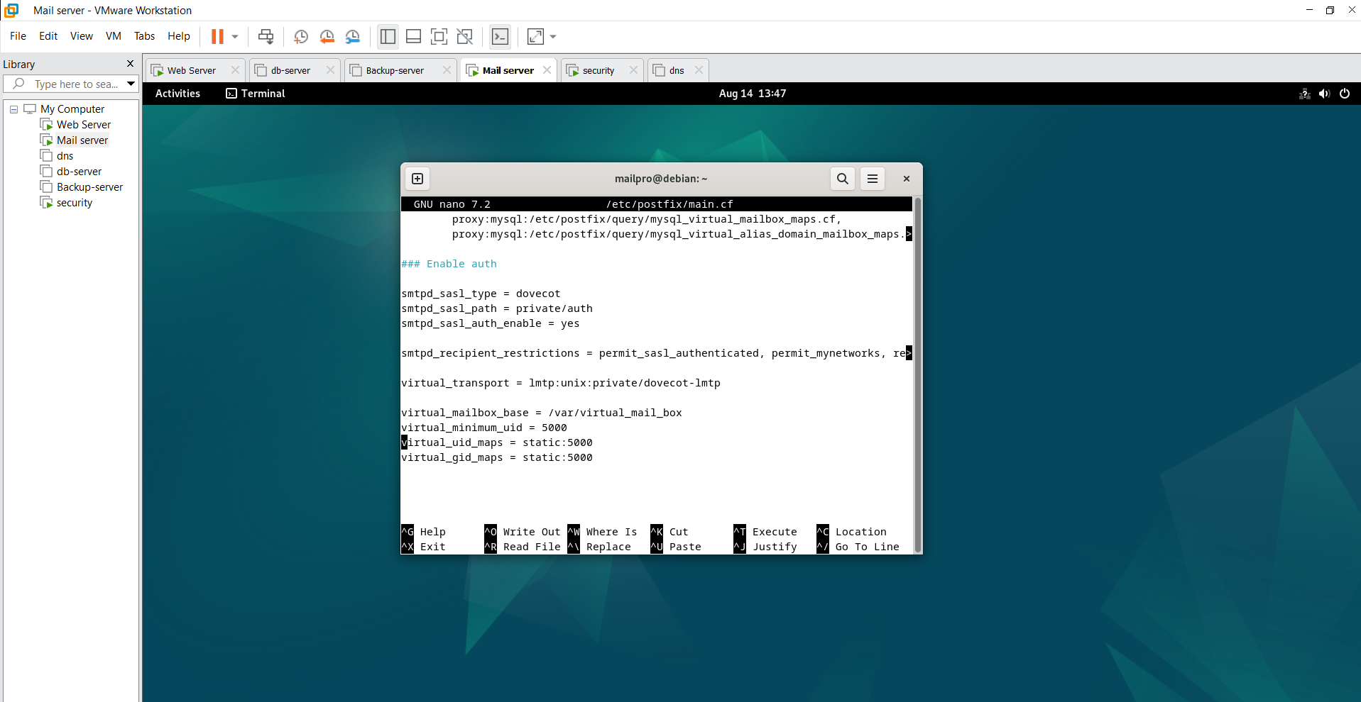
web server machine web hosted files on Git
Mail server machine

Slide 10
Conclusion
Accessibility and Speed
Control and Security
Cost Considerations

Slide 11
Future Scope
Hybrid backup strategies
Focus on data Confidentiality, Integrity, and Availability
Compliance and regulatory requirements
Enhanced Security Measures

Slide 12
Thank you

